Slide 1

ARTIFACT OOP Project
Thai Thanh Phat ITITIU21274
Game mechanic, Gameloop, Collision, Debugger, Git, Utilz
Vo Hoai Bao ITITIU21038
GUI, Sound, UML, Maps, Utilz, Gamestates
Truong Dinh Toan
ITITIU21332
Inputs, Entities, Utilz
Nguyen Duc Duy ITITIU21008
Objects, Levels, Utilz
Welcome to our game

Slide 2
01
Group members & Task allocation
02
Story
Introduction
TRAN VIET TRUNG
ITITWE22116
HO NGOC AN ITITIU21146
UML, Gameloop, Debugger, Git, Utilz
GUI, Sound, UML, Maps, Utilz, Gamestates
04
03
Tutorial
Design & New features
PHAM MINH NGUYEN
ITITUN21033
06
UML - Diagram
05
Objects, Levels, Utilz
4 Properties of OOP

Slide 3
TABLE OF CONTENTS
01
Introduction
02
Story
03
Tutorial
04
Design & New features
05
06
UML - Diagram
4 Properties of OOP

Slide 4
Introduction
01
This is our object-oriented programming game project at HCMIU in semester 2 (2022-2023).
It's a classic platform game where the hero battles monsters and faces traps while on a quest to defeat the dark knight.

Slide 5



ARTIFACT
Game project for OOP course at HCMIU.
Classic platform game genre.
Hero vs monsters and traps.
Quest to defeat dark knight.
Motivation.
THE STORY

Slide 6
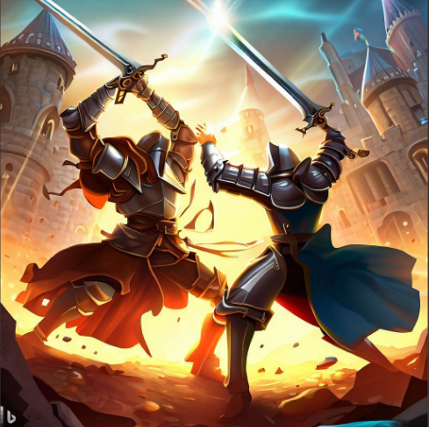

THE STORY
02

Slide 7
THE STORY
Artifact: a thrilling quest game.
Goal: become a legendary Hero and defeat the dark knight.
4 levels, pixel art, retro music.
Challenges: monsters and traps.
Technology: JAVA on Visual Studio Code.

Slide 8
TURTORIAL
03

Slide 9
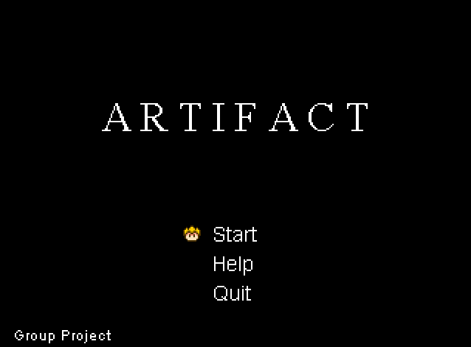

03. HOW TO PLAY
“Play” to start the game.
“Help” for knowledge about how to play game.
“Quit” to close the game.

Slide 10
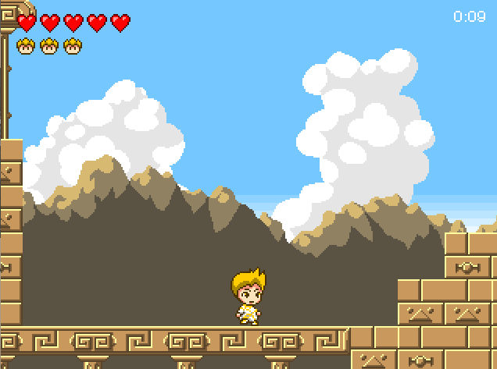
03. HOW TO PLAY
Move: W, →, ←.
Attack: R.
Dash: F.
Defeat all the enemies and you will pass the level.

Slide 11
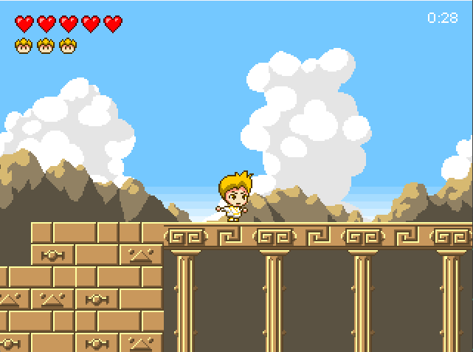
03. HOW TO PLAY
Hold E and the button →,← to run.

Slide 12
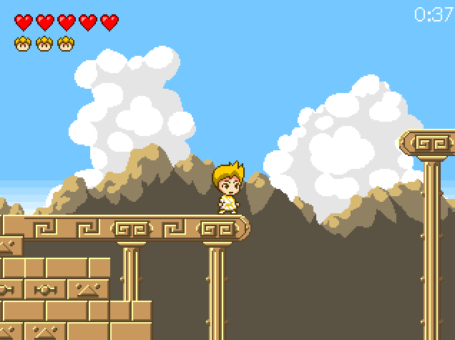
03. HOW TO PLAY
Fall into a abyss the game will start over

Slide 13
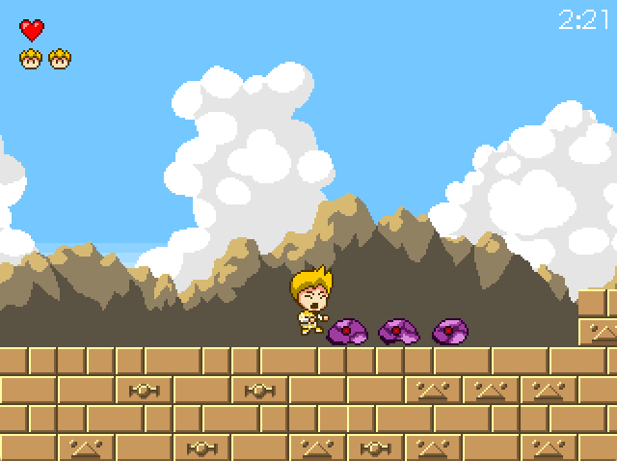
03. HOW TO PLAY
If you get hit by bullets, you will lose HP.

Slide 14
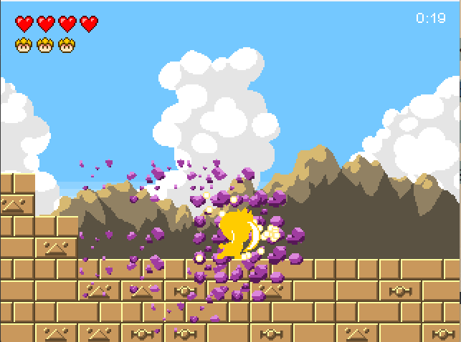
03. HOW TO PLAY
You can kill all enemies by F in a straight line when using das

Slide 15
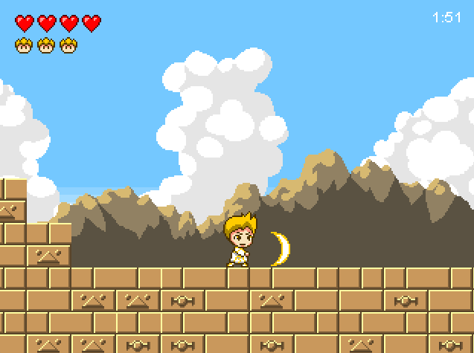
03. HOW TO PLAY
Use ulti R, the enemy will die.

Slide 16
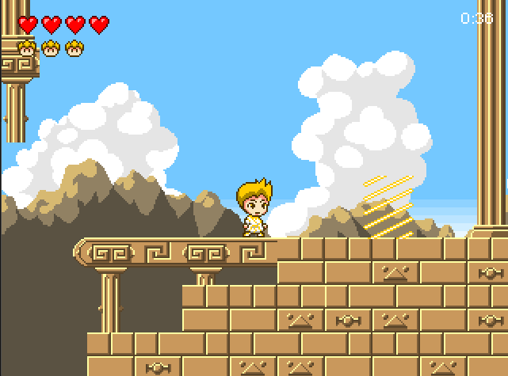
03. HOW TO PLAY
The place to move to the next stage.

Slide 17
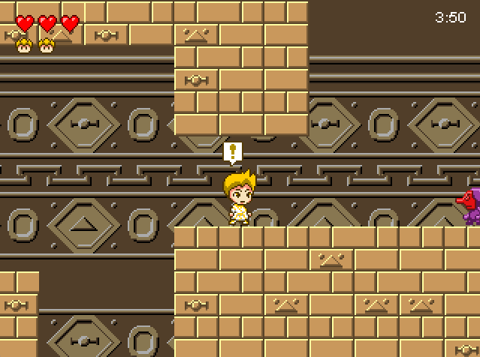
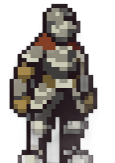
03. HOW TO PLAY
This is a sign that you are near the BOSS.

Slide 18
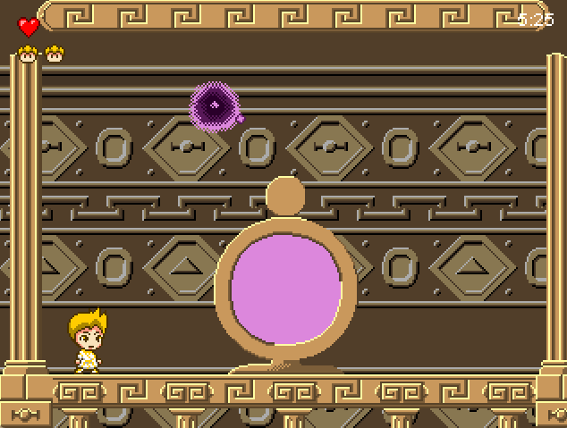
03. HOW TO PLAY
You need to kill the BOSS to win this game.

Slide 19
03. HOW TO PLAY
Fight the boss with F.
Using R with ↑ will control the skill to damage the boss.

Slide 20
Design & New features
04

Slide 21
04. Design & New features
BufferedImage for image files and pixel color manipulation.
Pixel colors for game components with RGB channels.
Level class for level data and game elements.
Google resources for optimization.

Slide 22
04. Design & New features
Keyboard control for movement and attack.
Slashing move until hitting tiles.
Tutorial at the start.
Bosses at the end.
Jumping costs energy.
.

Slide 23
04. Design & New features
Polymorphism
Inheritance
State pattern for modes and transitions in gamestates package.
Constants class for game constants.
Single Responsibilities pattern applied.
Design principle for readability and maintainability.
Abstraction
Encapsulation

Slide 24
4 properties of OOP
05

Slide 25
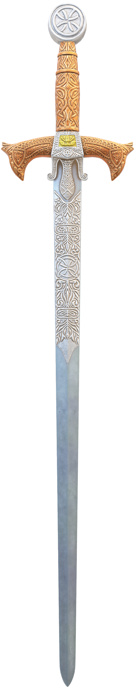
05. 4 properties of OOP
Encapsulation
Abstraction
03
04
01
02
Inheritance
Polymorphism
Encapsulation in our game project using classes like Player, Enemy, and Game
For example, the Player class has specific attributes
Attributes and methods are hidden.
Getters and setters

Slide 26
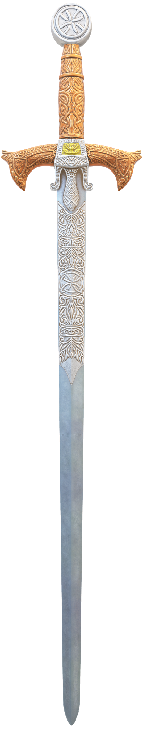
a) Encapsulation
- We used abstraction and interfaces to capture shared characteristics among game objects.
- Abstract classes like Enemy encapsulated common functionality for all enemies, promoting code reuse.
03
01
01
02
03
04
- The StateMethod interface guarantees consistent behavior across various game states.
- Abstraction improved modularity and maintainability, facilitating efficient representation of shared features and streamlined development.
02
04
Encapsulation in our game project using classes like Player, Enemies.
Attributes and methods are hidden.
For example, the Player class has specific attributes.
Getters and setters.

Slide 27
b) Abstraction
Abstraction and interfaces define common behaviors for game objects.
Enemy class.
01
03
Reducing code duplication. Promoting modular code.
Create subclasses for code reuse and hierarchy.
Abstraction enhanced modularity and maintainability of shared features.
02
The GameState interface.
04
For example, GameObject and Entity

Slide 28
c) Inheritance
Create subclasses for code reuse and hierarchy.
Reducing code duplication. Promoting modular code.
For example, MapObject and GameState

Slide 29
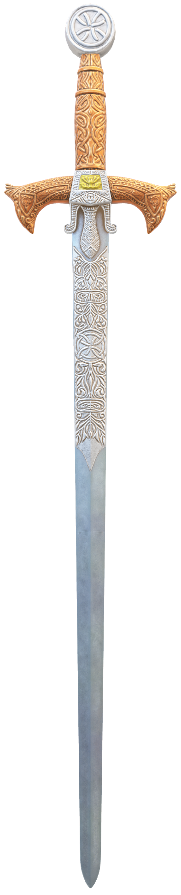
d) polymorphism
Utilz
Audio
Levels
The AcidState class contains GameState methods.
Depend on the type of collision.
Entities
Main
Game states
Objects
Do you have any questions?
Inputs
GUI
THANK YOU FOR YOUR LISTENING

Slide 30
Audio
UML - DIAGRAM
Entities
Game states
Levels
Main
Objects
Do you have any questions?
THANK YOU FOR YOUR LISTENING

Slide 31
THANK YOU FOR YOUR LISTENING
Do you have any questions?

